Slide 1
Wolves
By: Joshua Mayer

Slide 2
Youth
Pups stay in their den until 5 weeks old
Pups are born blind
Pups get weaned in the 5th week
On the 5th week the pups are old enough to run with the pack
Wolves mature from 22-24 months of age

Slide 3
Description of a Wolf
Color of their coat can vary from pure black to pure white and anything in between
They stand 2.5 feet tall at the shoulders, and five feet long
Wolves weigh from 100-175 lbs.
Pups are born in spring but will be their adult size by the winter.

Slide 4
Pack Life
Wolves travel in packs in size from one individual, up to 20
All of the wolves in the pack will help adopt or babysit the pups if the parents of the pup are unable to do so
Wolves hierarchy is very strict, running alpha male or female as ruler and extending from there
The supreme ruler can be either male or female

Slide 5
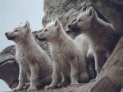
Notes:
Wolf pups on the lookout for their parents

Slide 6
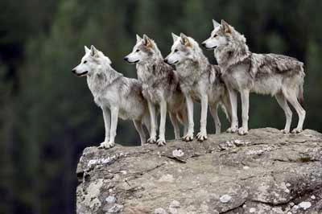
Notes:
Some wolves watching their prey

Slide 7
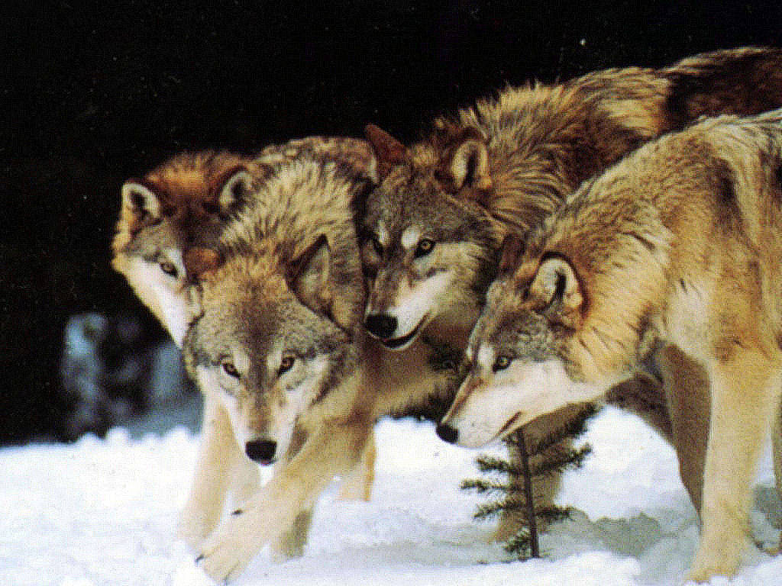
Notes:
A pack of wolves on the hunt

Slide 8
Communication
Wolves have a complicated communication system
Communication includes postures, looks, glances, etc.
You can usually tell which individuals are highest in the hierarchy by how erect their tail is

Slide 9
Lone Wolves
Sometimes a wolf will be driven from a pack
This wolf then is in a lot of danger of starving attack from a different pack, etc.
This wolf can only become a part of a different pack if that pack chooses to accept them, or another lone wolf of the opposite gender to start a new pack

Slide 10
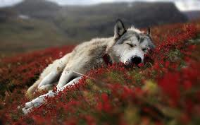
Notes:
This wolf is a lone wolf

Slide 11
Hunting
The pack relies heavily on numbers for the hunt to succeed
Wolves need cooperation and coordination to succeed and feed their packs
In winter wolves will use frozen rivers or lakes as highways
Wolves will use their sense of smell to hunt and it is 100 times stronger than ours

Slide 12
Hunted
Wolves are apex predators and are not hunted in the natural world, although we keep hunting and killing them
Wolves once lived all over the U.S. but are now confined to a small area
Numbers of wolves numbers have dwindled with the growing of human population

Slide 13
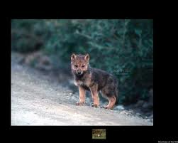

Slide 14
Bibliography
www.fanop.com
www.animals.howstuffworks.com/wolves
www.softpedia.com
www.theboldcorsicanflame.wordpress.com
www.nwf.org
www.worldbook.com/student
www.fangedwolf.tripod.com
My book: The Wolf
Notes:
These are the websites that I got my pictures from.^.^

