Slide 1
Dominique Moceanu (Moe-chee-ah-new)
By Madison Mauch
For Mrs. Bean’s Class

Slide 2
General Gymnastics
Floor, beam, bars and vault
A perfect score is 10.0
Advanced moves, no falls, less spots, and good form

Slide 3
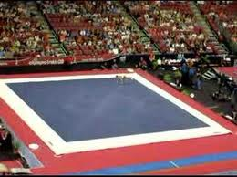
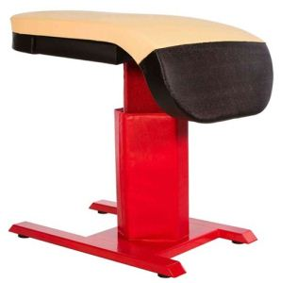
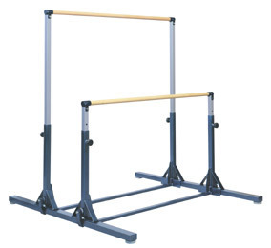
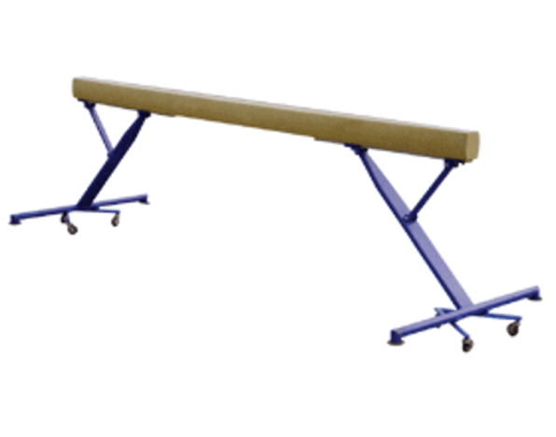
Gymnastics Pictures

Slide 4
Background Information about Dominique Moceanu
American champion.
Born in Hollywood but both her parents are from Romania.
Moved to Illinois when three
Moved to Florida when 6
Moved to Houston to train with Bela
September 30th

Slide 5
How does Dominique handle stress? How is she so good?
Get good sleep
Be totally focused 100% of the time
To master something, do every event twice a day
Muscle memory
If you can’t deal with stress
Pretend nobody’s watching

Slide 6
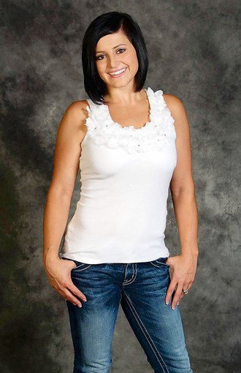
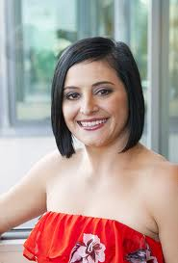
Dominique Today

Slide 7
Fun Facts
Favorite: Beam and floor
Invited to White House
2004 realized bobble head
Commercials: Wheaties, Kodak, National Bank, and Gallery Furniture
Youngest to be on a Wheaties box

Slide 8
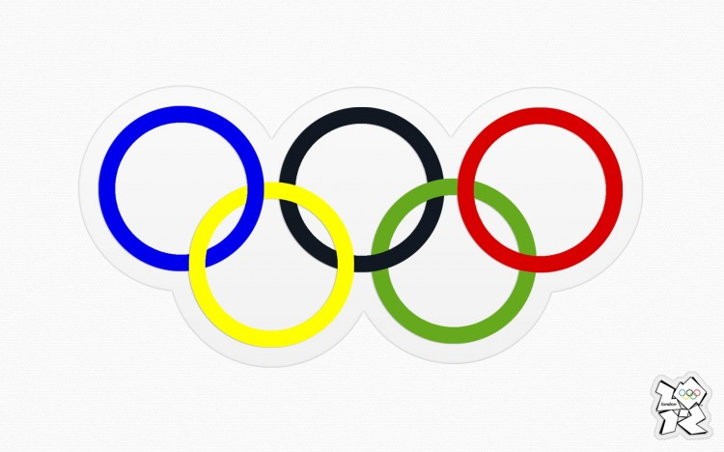
Her Olympic Journey
Went in 1996
Music: The Devil went to Georgia
*Won a gold medal for team

Slide 9
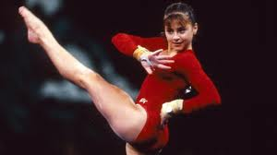
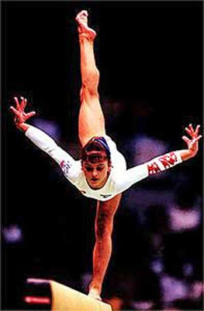
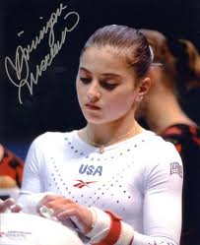
Dominique as a Gymnast
t

Slide 10
Thanks (You can applaud)
Thanks for watching and I hope you enjoyed the show
Thanks to
http://www.magerempowerment.com/v2/blog/?p=1448
http://articles.latimes.com/2012/aug/04/health/la-he-five-questions-moceanu-20120804
http://www.dimensionsinfo.com/gymnastic-uneven-bars-height/
http://www.american-gymnast.com/shop/Performance-Series-Vault-Table-with-Column-Padding-P294.aspx
http://health.asuw.org/2012/04/16/happy-national-stress-awareness-month/
http://www.ebay.com/itm/DOMINIQUE-MOCEANU-Olympic-Gymnastic-Gold-Autographed-/140515566568
http://morgantownlawladies.blogspot.com/2011/03/goals.html
http://www.google.com/url?sa=i&rct=j&q=dominique+moceanu&source=images&cd=&cad=rja&docid=GOWPAC92rogXGM&tbnid=XRzY8kKDReeDiM:&ved=0CAQQjB0&url=http%3A%2F%2Folympics.wikia.com%2Fwiki%2FFile%3ADominique_Moceanu.jpg&ei=FVo2UbisJ_LyyAHNtoDgAQ&psig=AFQjCNEqaMNh-X90KBwg04s5cxYTWIFA0g&ust=1362602643606216
http://www.google.com/url?sa=i&rct=j&q=olympics&source=images&cd=&cad=rja&docid=PXvBt5HQBaJpvM&tbnid=_Vvc_IMmRk3lzM:&ved=0CAQQjB0&url=http%3A%2F%2Fdesignyoutrust.com%2F2012%2F07%2F2012-olynmpics-wallpaper-freebie%2F&ei=QVw2UaiiLKKbygG1-4GYAg&bvm=bv.43148975,d.aWc&psig=AFQjCNGIq-v79mBh9k9tMG-45Q2drD2Pfg&ust=1362603440034534
Dominique Moceanu: An American Champion

